Slide 1

Yellowboi Unity
By Dominic London

Slide 2
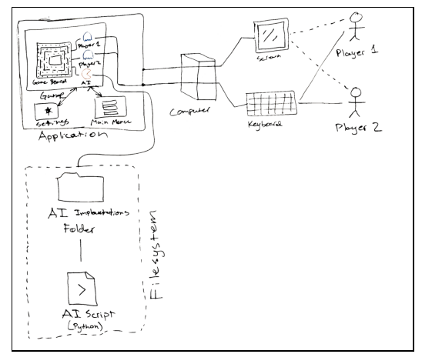
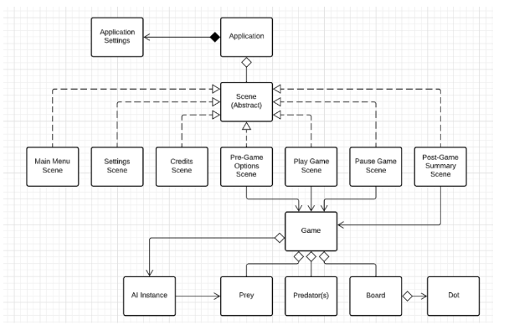
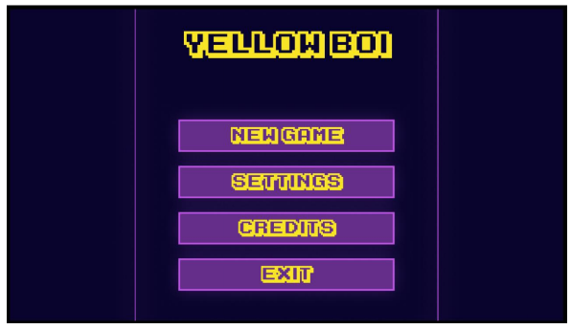
Original Plan and design

Slide 3
Why Unity

Slide 4
Demo

Slide 5
Release Notes
Only 1 level currently
Controller is unresponsive on Windows 11
AI isn’t fully implemented correctly yet.
Settings menu is a placeholder until functions for game are made

Slide 6
Proper credit given and thank you audience
Zigurous: For overall pacman unity structure and tutorial
Software Engineering Team for original idea and concept work
Aron Granberg for A* pathfinding project

